Slide 1
DECIPHERING MICROBUSINESS DENSITY GROWTH
Data Mining Platforms
Group 5
Mar 6, 2023

Slide 2






Group Members
Han Jiang
Ken (Yang) Wu
Helena (Xiaorou) Hu
Bryan (Junhao) Yang
Jade (Rujia) Yuan
Sam (Zihao) Ding

Slide 3

AGENDA
01. PROBLEM STATEMENT
Case Introduction: Background and Purpose
02. DEFINITION OF VARIABLES & EDA
Dataset Overview: Size, Variables, Missing Values & Outliers
EDA: Data Distribution, Correlation, and Relationships
03. METHODOLOGY
Data Impute
Feature Engineering
Model Build-Up
04. CONCLUSION & RECOMMENDATION
Findings
Business Solution & Recommendations

Slide 4


Problem Statement
Microbusiness is a significant composition of both the local community and national economy.
However, due to the size limitations, it is difficult for stakeholders to track micro-business development, and provide further resources to boost growth.
By combining data collected by GoDaddy, a domain registrar and web hosting company, and demographic information & macroeconomic indicators, we, as a business consulting team, are here to present our data mining findings and solutions, in order to:
Help policymakers to identify microbusiness pattern and improve resource allocation.
Facilitate investment decisions of institutional investors such as loan providers and venture capitalists.
Notes:
Microbusinesses are often too small or new to appear in traditional economic data sources, which makes it challenging for policymakers to gain insights into their growth patterns and driving factors. However, microbusiness activity is often correlated with other economic indicators of general interest, making it essential to understand the monthly micro-business densities of U.S. counties. To address this issue, our project aims to provide policymakers with valuable insights into the development of micro-businesses in the U.S. counties.
Our approach involves combining Godaddy data on Kaggle with additional data sources such as demographic information and macroeconomic indicators. By analyzing these data sets, we aim to reveal viable strategies that policymakers can employ to boost the growth of microbusinesses. Additionally, we seek to identify investment opportunities for financial institutions, such as loan providers and venture capitalists.
In conclusion, our project will provide policymakers with valuable insights into the growth patterns and driving factors of micro-businesses. With this knowledge, policymakers can make informed decisions to support the development of micro-businesses, which will promote economic growth and job creation in U.S. counties.

Slide 5
DEFINITION OF VARIABLES & EDA
Dataset Overview:
122,265 observations in total
Microbusiness Density (Microbusiness per 100 ppl over 18 years old) as target variable
Over 20 predictor variables, such as county, date, median household income, housing rents, treasury yield, etc.
90,916 missing values appear in county-level data of % IT workers, % foreign born, median household income, % broadband access, and % college degree
Outliers are identified by checking the distribution and interquartile range of variables. Outliers in target variable are scaled, while other outliers are removed or transformed on a case-by-case basis
county
month
% IT workers
state
year
% foreign born
Microbusiness Density
Med. house- hold income
Unemploy-ment rate
Housing rent
% college degree
Treasury yield (10yr)
Annual tax rate
Notes:
Microbusinesses per 100 people over the age of 18 in the given county. This is the target variable. The population figures used to calculate the density are on a two-year lag due to the pace of update provided by the U.S. Census Bureau, which provides the underlying population data annually. 2021 density figures are calculated using 2019 population figures, etc.

Slide 6
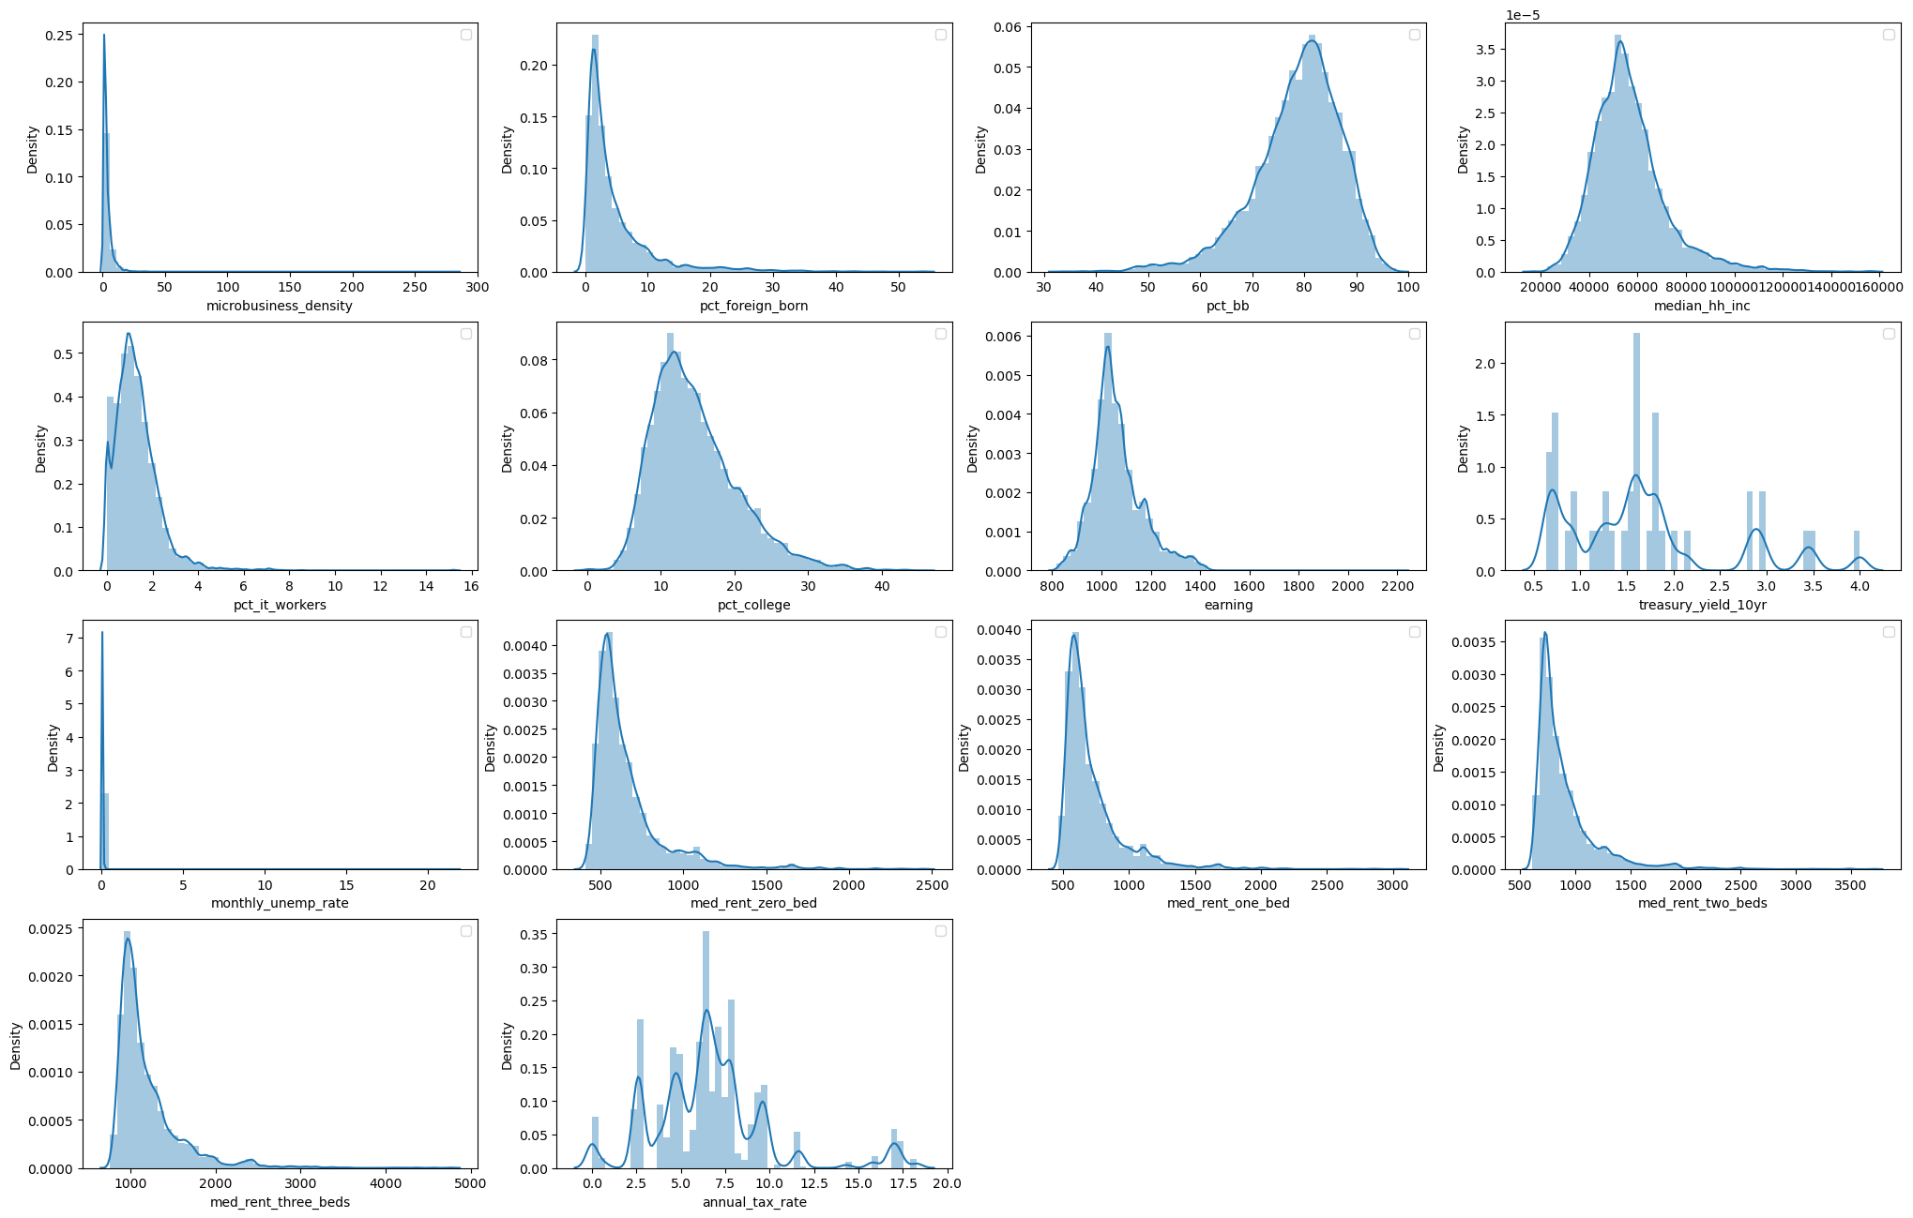
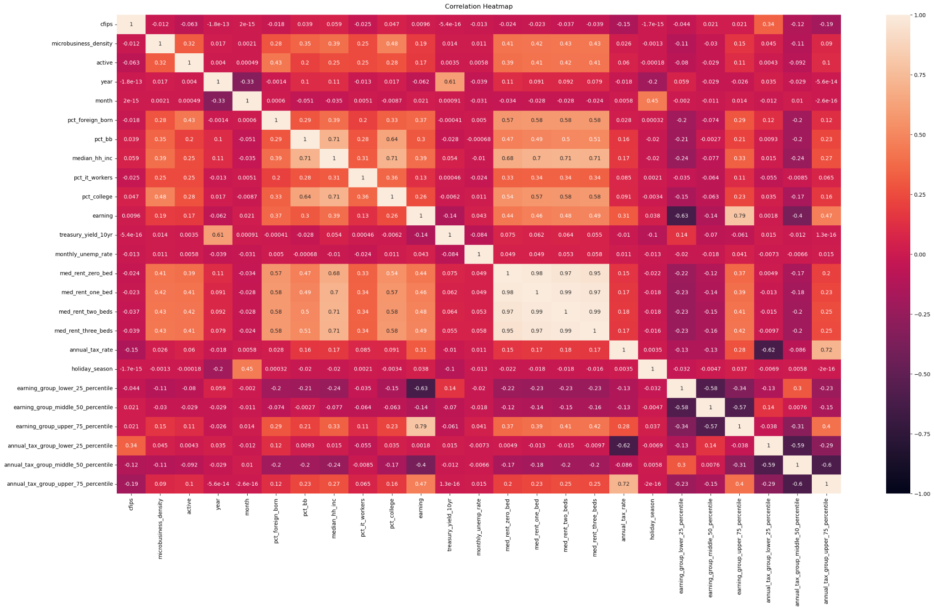
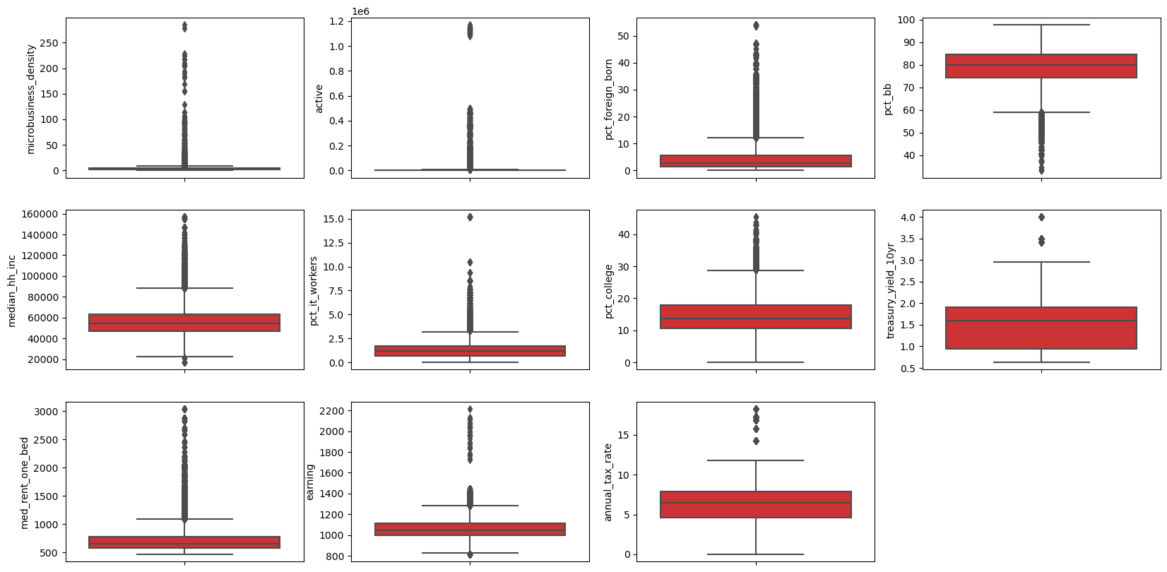
DEFINITION OF VARIABLES & EDA
Majority of continuous variables are right-skewed
Box plots also show both our target variable and features have many outliers
Microbusiness_density has relatively high correlation with broadband internet access percentage, household income median, college rate and housing rents.
Notes:
Thanks Bryan, we first take a look at the distribution of all variables. We notice that the majority of of them are right-skewed. The box plots here also confirm both our target variables and features have a bunch outliers. Like Bryan mentioned before, we later scaled our target variable and removed or transformed outliers in features.
The correlation matrix here shows our target variable, Microbusiness_density, has relatively high correlation with broadband internet access percentage, household income median, college rate and housing rents. We then further analyze if there’s any actual relationship between the target variable and those features.

Slide 7
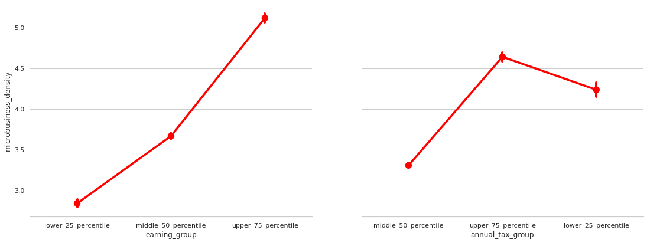
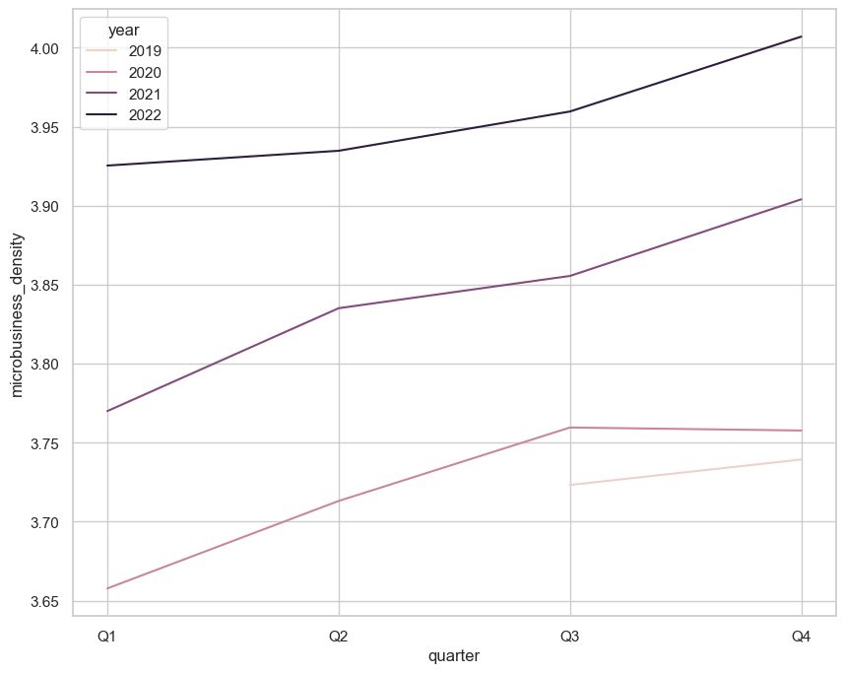
DEFINITION OF VARIABLES & EDA
Microbusiness density increases over the years
Q4 usually has the highest density
Microbusiness density is positively related to the average household income.
High microbusiness density only occurs in region with tax that is either higher than 75 percentile or lower than 25 percentile.
Notes:
Here is some interesting findings we found in our EDA process. We notice microbusiness density is positively related to the average household income, but high microbusiness density only occurs in region with tax that is either higher than 75 percentile or lower than 25 percentile. The general trend for micro business density is increasing over the years, and Q4 usually has the highest density among all quarters.
** A possible rationale is that small business might grow in places with relatively developed economy (and thus it is associated with high income tax). Otherwise, microbusiness tends to grow where income tax is low.

Slide 8
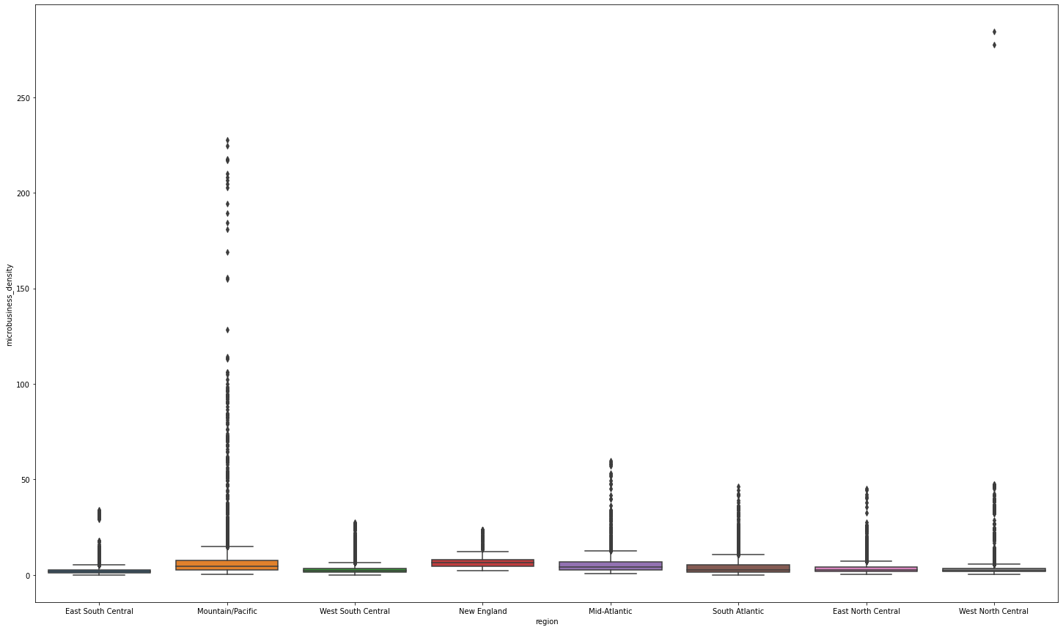
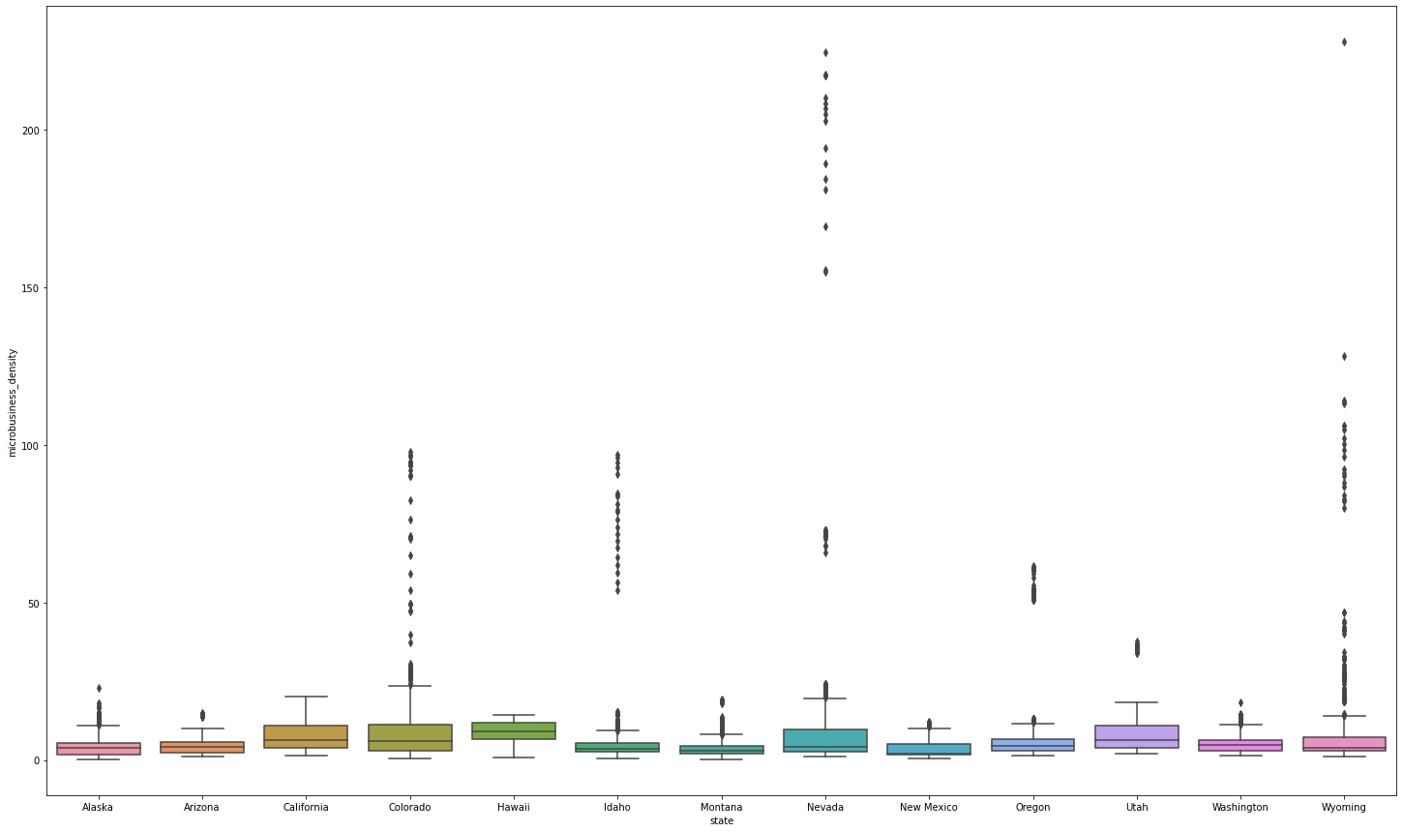
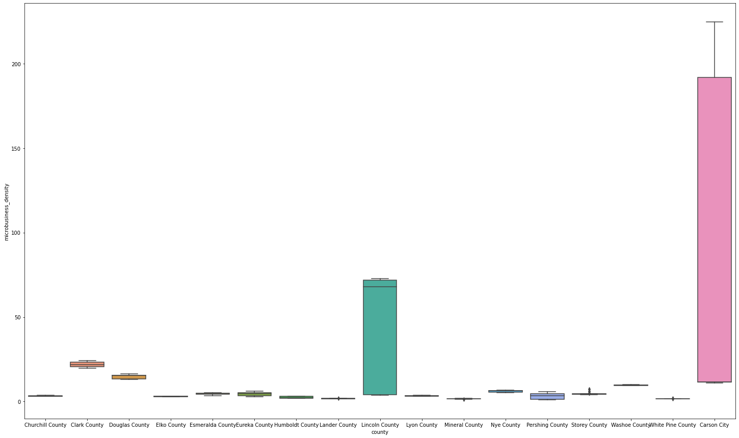
DEFINITION OF VARIABLES & EDA
Microbusiness Density VS. Regions
Mountain/Pacific Region
Nevada State
Carson City
Lincoln County
Notes:
We also visualize the relationship between micro business density and geographic regions. Given we have 50 states plus District of Colombia in our dataset, we decided to group them into 8 regions for easier visualizations. For the box plot chart on the left, we notice Mountain/Pacific Region has the most outliers, where there are many data points with high microbusiness densities, so we decided to take a closer look at this specific region. We found that there are a couple states in this region having substantial amount of outliers, so we further zoomed in to the Nevada State, which served as a representative of states with high microbusiness density outliers. Now we see that Carson City and Lincoln County are the two counties with very high microusiness business density compared to other counties in Nevada State, and that's the reason why we see such dispersed data for Nevada. This is just one illustration of what we found between microbusiness density and geographic regions in our EDA process. I’ll then pass on to Rujia to give us a more comprehensive view of those two variables with the use of Geoplots.

Slide 9
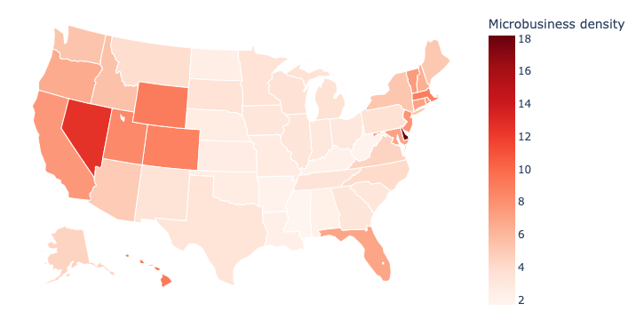
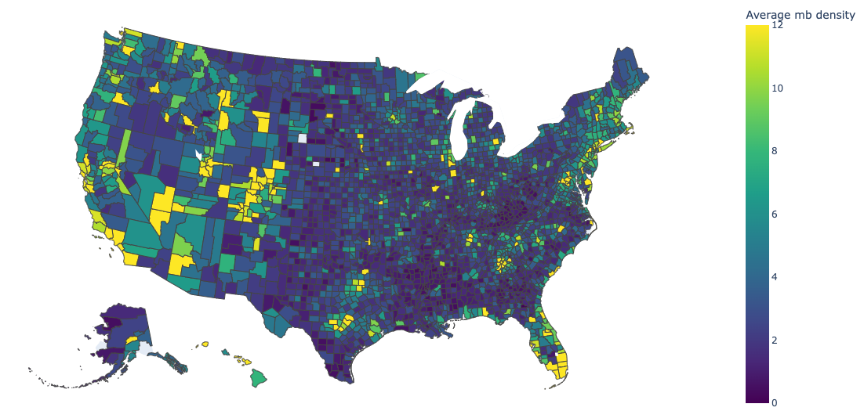
EDA - GIS VISUALIZATION
State-wise, we see that the East Coast and the North-West Coast of the U.S. have higher micro-business densities than others
Top three counties with highest average microbusiness density are: Carson City(NV), Sheridan County(WY), Rio Grande County(CO). However, their trends of micro-business density differ (e.g. Carson City’s short peak)
Bottom three counties with lowest average microbusiness density are: Issaquena County(MS), Echols County(GA), and Greensville County(VA)
With basic census information, we see counties with highest micro-business density has an above-average level of access to the internet, percentage of foreign born people, and median household income; the bottom 1 county has the opposite
Average Micro-Business Density by State
Average Micro-Business Density by County
Notes:
So now let’s take a look at two geo plots, the left one shows the average micro business density for the states, and the right one is more specified for the counties. Generally, we can directly see that our target variable varies by states, with the east coast and north west coasts have obviously better results. And if we look closer into counties, the top county with highest densities are Carson, which can be reflected also before in the region study. The bottom counties are shown here as well. One thing to be notified is that such results can be differed because of time. Overall the counties with higher values always have higher level of access to the internet, higher percentage of foreign born people, and higher median household income, which fits our previous result of correlation matrix.
Specifically,
For Carson City:
access to the Internet grows and in 2021 was around 86% which is above the US average
median household income grows and in 2021 was about 62 000 dollars per year, which is also above US average.
percentage of foreign born people grows but stabilises at 12.8% (↔). This is a high number considering US average.
percentage if IT workers dropped a bit and came back to the original level (↔) to about 1.5%.
For Issaquena County:
the number of IT workers was always 0 (↔)
access to the broadband Internet dropped
number of foreign born person dropped to 0
median household income dropped significantly below 18 000 dollars

Slide 10
PREPROCESSING & FEATURE ENGINEERING
1
CENSUS DATA
IMPUTATION
Interpolated monthly data— percentage foreign-born, percentage broadband access, percentage college graduates, using yearly-updated values
Missing values were thoroughly investigated and imputed appropriately given the data type, descriptive stat- istics, and considerations of downstream analytical needs. All imputations and rationales are summarized in the appendix.
2
3
ECONOMIC INDICATORS
Included new variables like earnings, rent, U.S. treasury bill rates, unemployment rate, tax rates, etc. from external sources
CATEGORICAL VARS
4
Engineered categorical variables for regionality, fiscal quarters, seasonality, covid, and binned continuous features
Notes:
We also want to talk a lil bit about our data preprocessing and feature engineering. Based on our dataset from Godaddy, we additionally collected related census data like percentage of foreign born people, and some economic indicators like earnings. Then, we cleaned our data carefully. For example, for the missing data, we imputed them with different methods appropriately such as using the median or last year’s . If you are interested in more details, we can show you later in the appendix. Besides, for the categorical data, we make dummies or just divide them into different columns for regions, fiscal quarters, COVID periods, and so on.

Slide 11
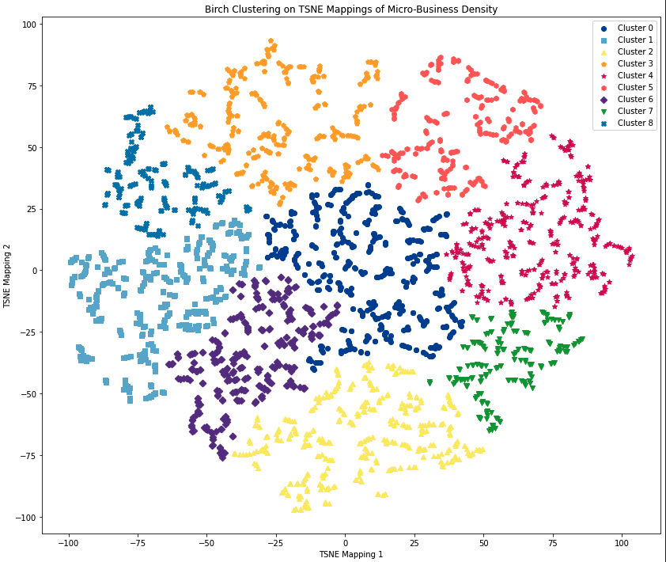
CLUSTERING WITH BIRCH
Number of clusters selected based on distortion score and Calinski-Harabasz Index (higher = better defined clusters) recommended by the literature.
Visualization uses TSNE with tuned perplexity and learning rate, and initialized using PCA.
This clustering model is compared with Optics, HDBSCAN, and direct Agglomerative Clustering; the most sensible model is selected based on business interpretation needs that follow— i.e., trade-off between too many clusters and too few.
Notes:
Balanced Iterative Reducing and Clustering using Hierarchies is an algorithm that scales fairly efficiently.
BIRCH summarizes large datasets into smaller, dense regions called Clustering Feature (CF); this is a tree structure. It does it by generating a small and compact summary of the large dataset (N, LS, SS) that retains as much information as possible before performing clustering using the CF tree.

Slide 12
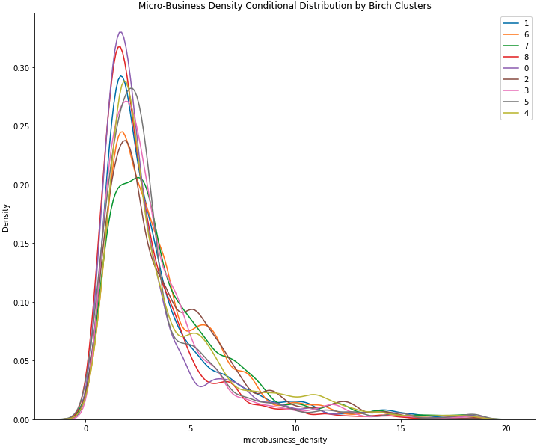
CLUSTERING EVALUATION
Business Question: Is the chosen clustering model useful for segmenting and capturing the differences in the distributions of micro-business densities to aid business interpretations?
Approach: We use KDE to estimate the conditional densities and conduct pairwise Kolmogorov-Smirnov test on simulated samples. All conditional distributions are found to have distributions that are not identical.
Test results are included in the notebooks.

Slide 13
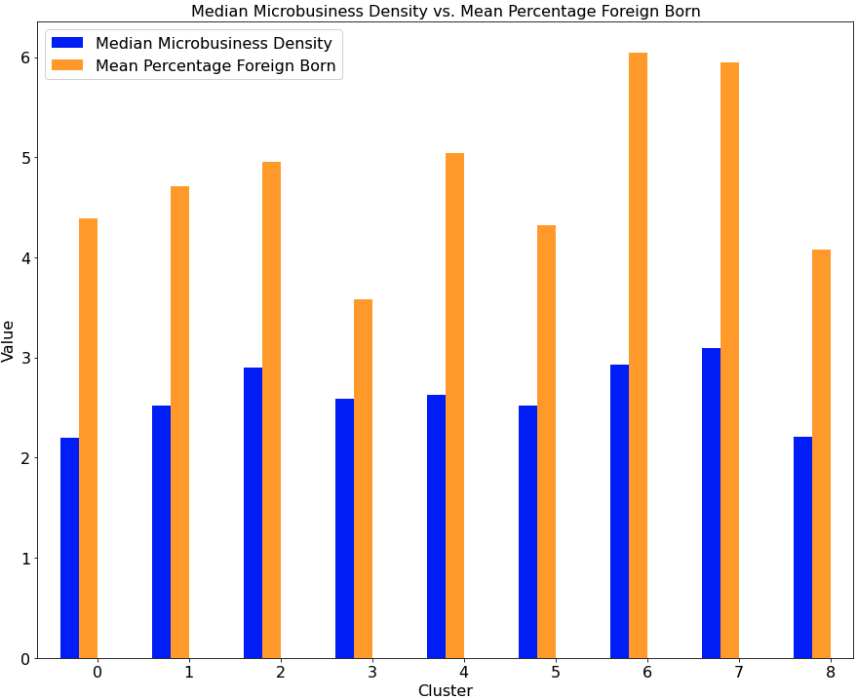
CLUSTER CHARACTERISTICS
Highest (cluster 7): 3.09
Second Highest (cluster 6): 2.93
Key Characteristics of High Micro-business Density Clusters
The top two clusters with the highest median densities are also top two in percentage foreign born ~ 6 % and 5.9% respectively.
The top three clusters with the highest densities are also top three in median household income ~ 57,806 - 61,848.
The cluster with the highest median density is the cluster that has the highest percentage of college graduates at 16.35 %.

Slide 14
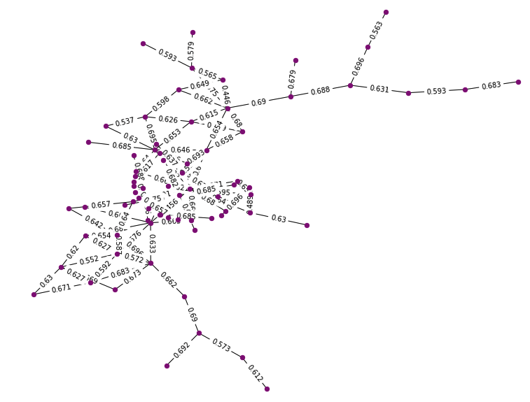
CLUSTER ANALYSIS (GRAPH NETWORK)
Business Question: What do high micro-business density counties look like? What attributes do they share in common?
Approach:
For cluster 7 (highest median micro-business density), construct a network.
Each node is a county
The edge/link attributes are the euclidean distances between pairs of counties
A link between a pair of counties exists if their euclidean distance is below a threshold (0.7)
Number of nodes: 73
Number of maximal cliques: 60
Average distance: 0.6260
Node with highest centrality: Salt Lake County, Utah
Degree centrality: 0.17
Closeness centrality: 0.23
Betweenness centrality: 0.21
We use this county as a baseline and find others that are similar to it
Notes:
There are a lot of cliques (or complete subgraphs), signaling a lot of communities of similar counties.

Slide 15
CLUSTER ANALYSIS (NEAREST NEIGHBOR)
Regionality
Favorable Tax Policy
8 of 11 (72 %) of these counties are in mountain/pacific coastal states.
01
02
The average annual marginal corporate tax rate is 5.4 % compared to 6.6 % for out-of-cluster counties.
03
Socio-Economic
Broadband Access
Unemployment: 4% v.s. 6% (out-of-cluster)
Education: 26% v.s. 14% (out-of-cluster)
Foreign-born: 8% v.s. 3% (out-of-cluster)
All 11 counties have > 85% (6 of them have > 90%) of population with broadband access compared to 78% average for out-of-cluster counties.
02
04
10 Nearest Neighbors of Salt Lake County
County | Marin, CA | Placer, CA | El Paso, CO | Pitikin, CO | San Miguel, CO | Canyon, ID | Douglas, KS | Davis, UT | Fauquier, VA | Winnebago, WI
Closest City | SF | Sacramento | CO Springs | Aspen | Telluride | Boise | Lawrence | SLC | Warrenton | Oshkosh

Slide 16
PREDICTIVE MODELING FRAMEWORK
Preprocessing (Pipeline)
- Catboost encode for categorical features
- Imputation for missing values
Baseline
XGBoost Regressor
5-fold Cross Validation
Bayesian Optimization (Optuna)
- Tree Parzen Estimator
- HyperbandPruner for pruning unpromising trials
Modeling Approach
Preprocessing
- Detect and remove stationarity by first order differencing
- Decomposition and remove seasonality
Evaluation Metric:
- SMAPE (Symmetric mean absolute percentage error)
- RMSE
AR & MA Baseline
Result:
- Improved SMAPE over xgboost baseline without temporal component
Result:
- The middle 50% of target values in the validation sets range between 1.64 and 4.51; and so the our RMSE of 2.01 is large. Underfit (high bias).
ARIMA & SARIMA (county-level)
- Include lagged features
- First order differencing
Result:
- Best validation and test score (SMAPE) at 4.72
Notes:
Besides the findings from the unsupervised algorithms, we also provide a forecasting framework.
we offer county-level forecasting services for stakeholders whose business needs are more aligned with predictions of future trends of micro-business density growth

Slide 17
CONCLUSION
East, West Coast and Rockies
Trend
Overall, micro-businesses in the U.S. are growing
E
T
Generally, these counties have higher microbusiness density than others
High
Business
Density
Education
Infrastructure
I
E
College education might foster entrepreneurship and business acumen
Access to Internet are crucial for micro-business growth
L
I
Geoeconomic Characteristics
Labor Force
High foreign-born workers and low unemployment rate helps boost business growth
Counties with tourism resources or suburban areas bring more opportunities

Slide 18
RECOMMENDATIONS
Government Entities
which wish to boost local microbusiness
Improving broadband access, investing in workforce education of IT & digital literacy, providing favorable tax policy and labor regulations
1
Private Investors & financial institutions
Increasing access to venture capital and financing for targeted areas, such as providing micro-lending programs, community development financial institutions (CDFIs), or other financing options
2
Services Providers of microbusiness
Investing more resources on areas with high probability of micro-business growth, such as discount program for company domain sales, marketing tools (see actionable examples in appendix)
3
Non-profit Organizations
Facilitating local marginal groups through trainings (e.g. language, digital skills) to secure employment in micro-business and gig-economy
4
Notes:
Use cases:
Micro Business is too small to trace; but we are able to predict their emergence and growth
We have different types of clients, so we prepare different types of recommendations
For local governments, we can give a forecast of your local mb growth. And evaluate if your business environment is favorable for microbbusiness
For private investors, we can bring first-mover market advantages for you to pick the most suitable areas of investment. With more resources, we will be able to make forecast by business type or industry
This is similar for service providers. For example, a e-commerce microbusiness will need company domain site and marketing tools. But how do service providers know where and who to advertise given limited resources? (Azure and AWS can afford global advertising, but not every providers can afford)
For non-profit organizations, the same logic. Where should you allocate your resources?

Slide 19
THANKS!
Data Mining Platforms
Group 5
Mar 6, 2023

Slide 20
Appendix - Imputation
Missing values in some census data features are due to the fact that there are years covered in the training data when these features are not available in the census data— e.g., 2022. For these features, our imputation strategy can be summarized as follows:
For each unique value of ‘cfips’ (county ID), we use the median of the previous three years of data to impute the values for year 2022 if the year-over-year changes fluctuate a great deal.
For each unique value of ‘cfips’, we use last year’s data (2021) to impute the values for year 2022 if the year-over-year changes are not significantly different.
There is one county in the training set in which unemployment data is not available— Kalawao County, Hawaii. For these missing values, we impute using the state-level monthly unemployment rate as proxies of the county-level unemployment rates.
All above steps are detailed and explained in a single Jupyter notebook.

Slide 21
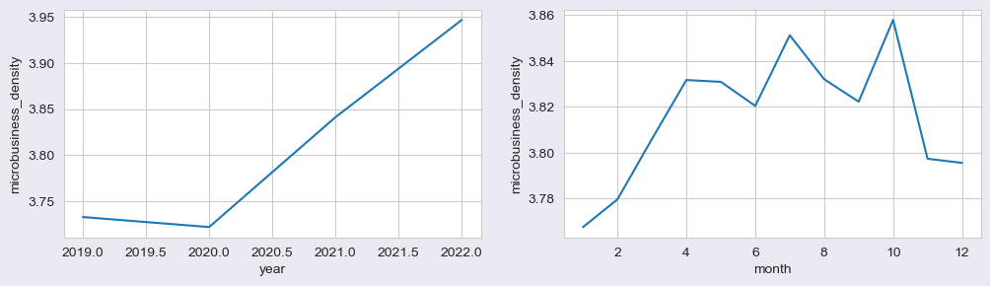
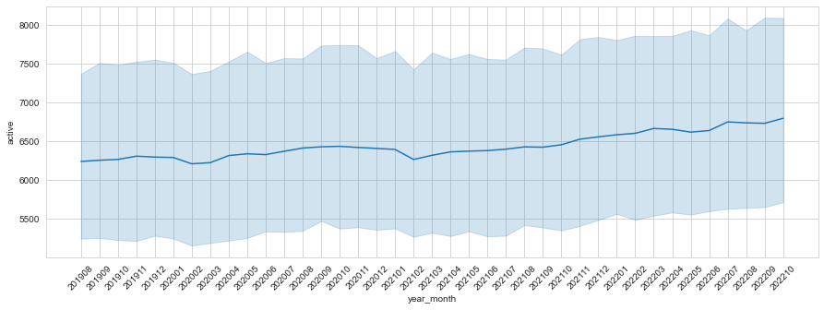
Appendix - EDA
Microbusiness_density increases over the years except a very small drop in 2022
May have some seasonality patterns, further explore that by adding new features ‘quarter’ and ‘holiday_season’

Slide 22
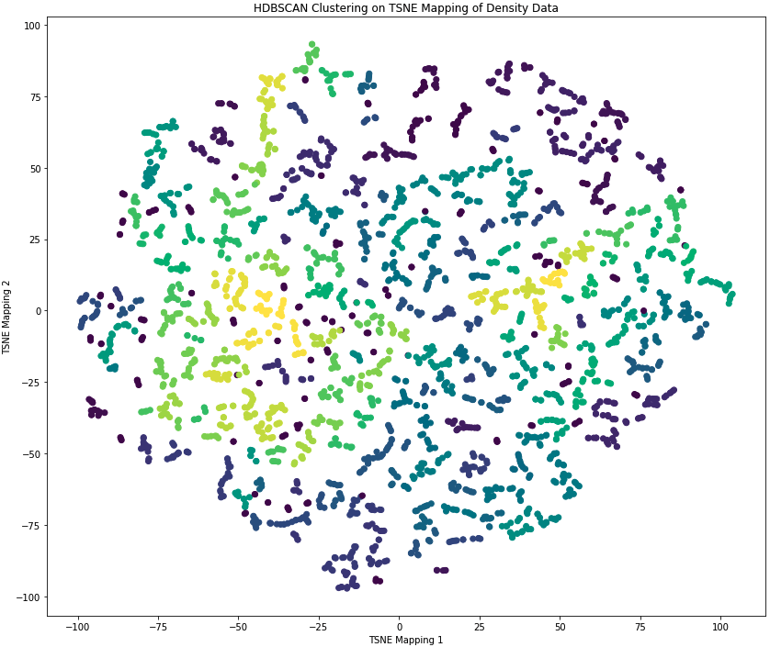
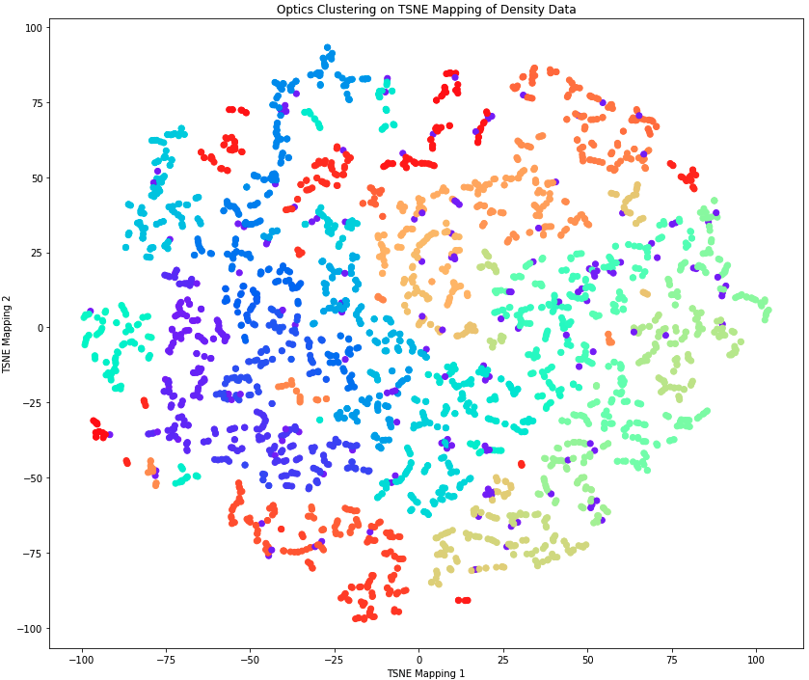
Appendix - Clustering Models
HDSCAN and Optics resulted in many clusters (> 500 and > 1000), which may not be conducive to business interpretations..

Slide 23
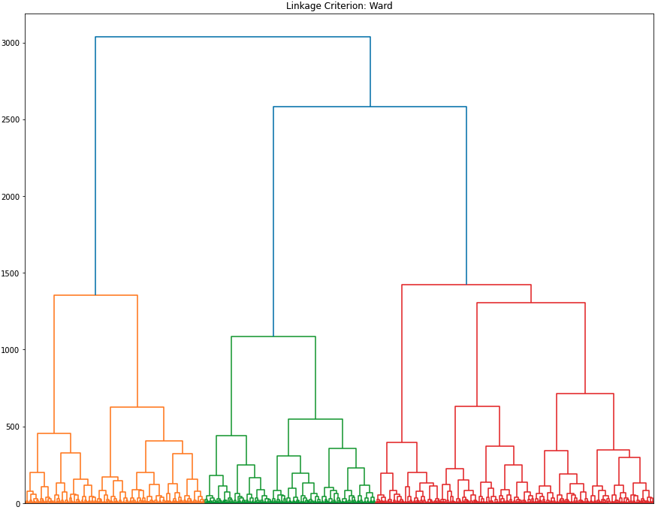
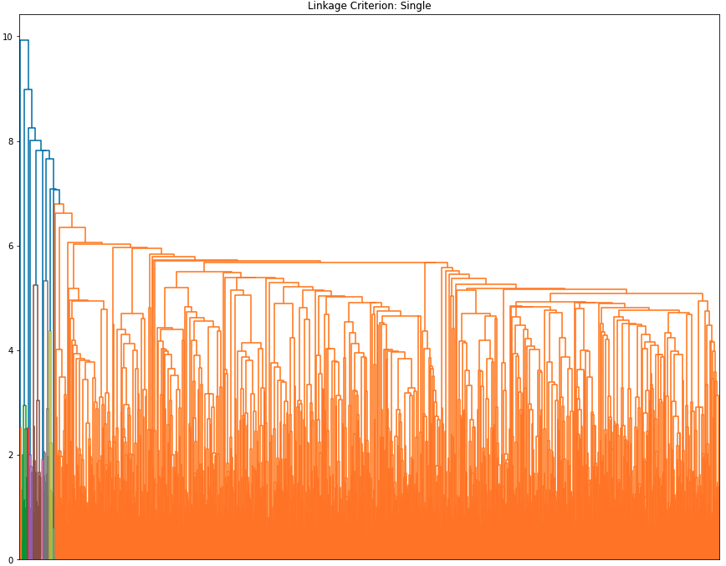
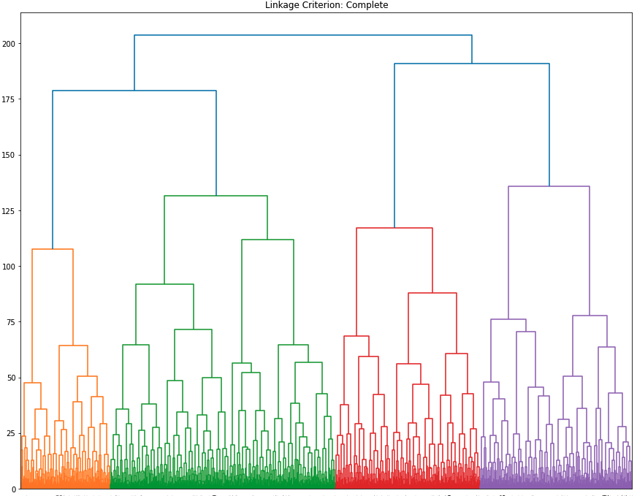
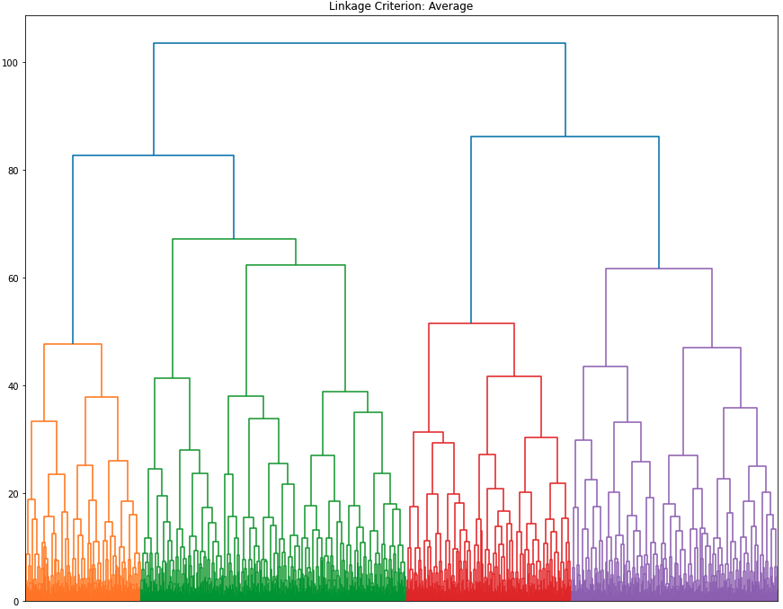
Appendix - Clustering Models
Agglomerative clustering resulting in the fewest number of clusters among all clustering models.
While the number of clusters are manageable, it may note be useful for segmenting and capturing the differences between micro-business density

Slide 24
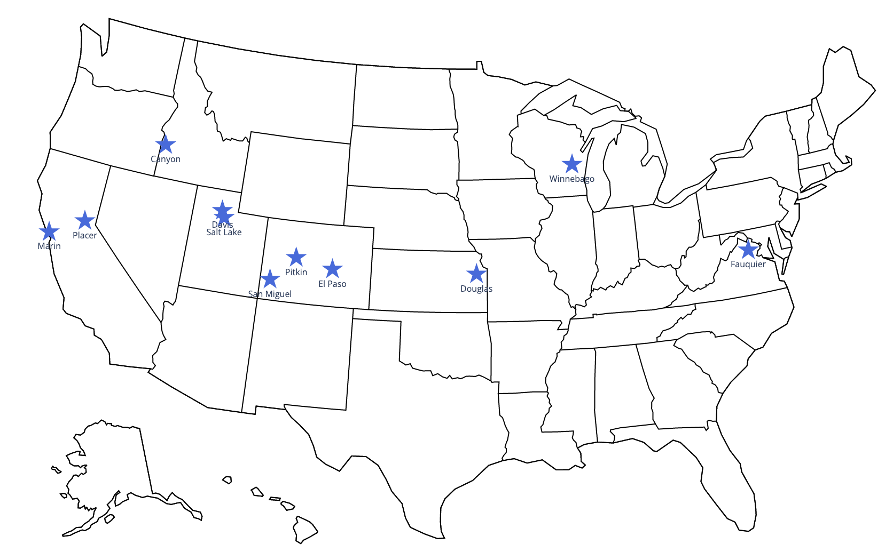
Appendix - KNN MAP
These are similar (neighbor) counties belonging to cluster 7, which has the highest median micro-business density.

Slide 25
Appendix - Micro-Business Programs & Services
Place County Micro Biz Grants
Davis County Community & Economic Development— Davis Fund
Marin County Micro-Business Grant
Pitikin County Small Business Resource Center
San Miguel County Small Business Resource Center
Douglas County E-Community Loan Program, Youth Entrepreneurship Challenge, E-Accelerator Program
Fauqueir County Micro-Loan Program
Winnebago County Small Business Development Program

Slide 26
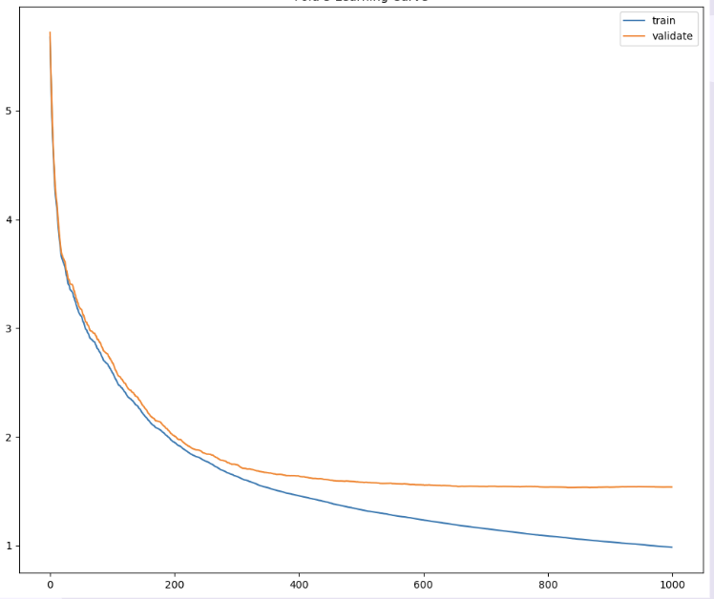
Appendix - Baseline Modeling Learning Curve
Baseline model converges to an error rate of around ~ 2, which signifies underfitting
Begins to overfit at around 300 rounds of boosting

Slide 27
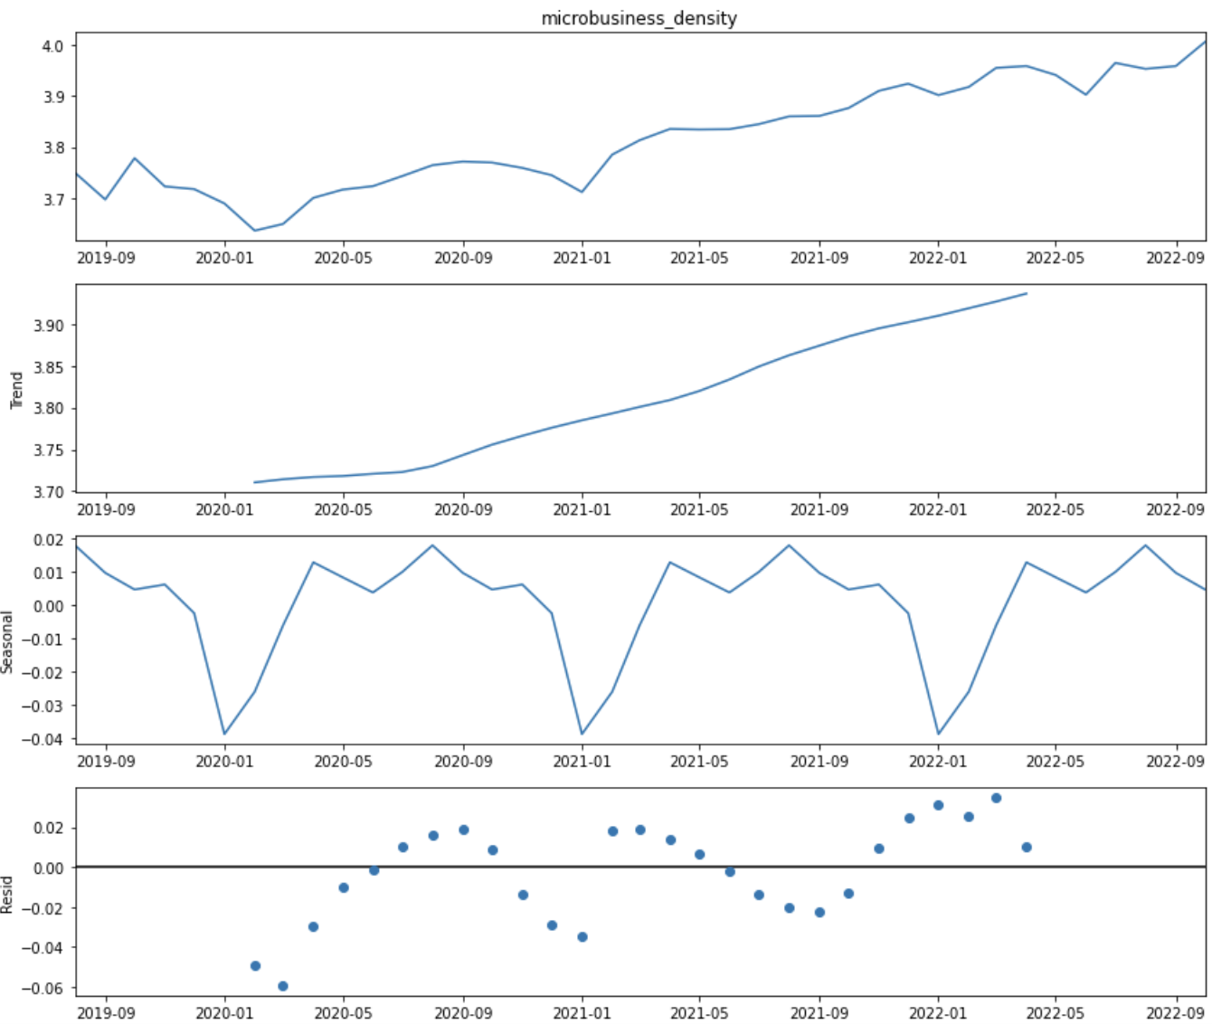
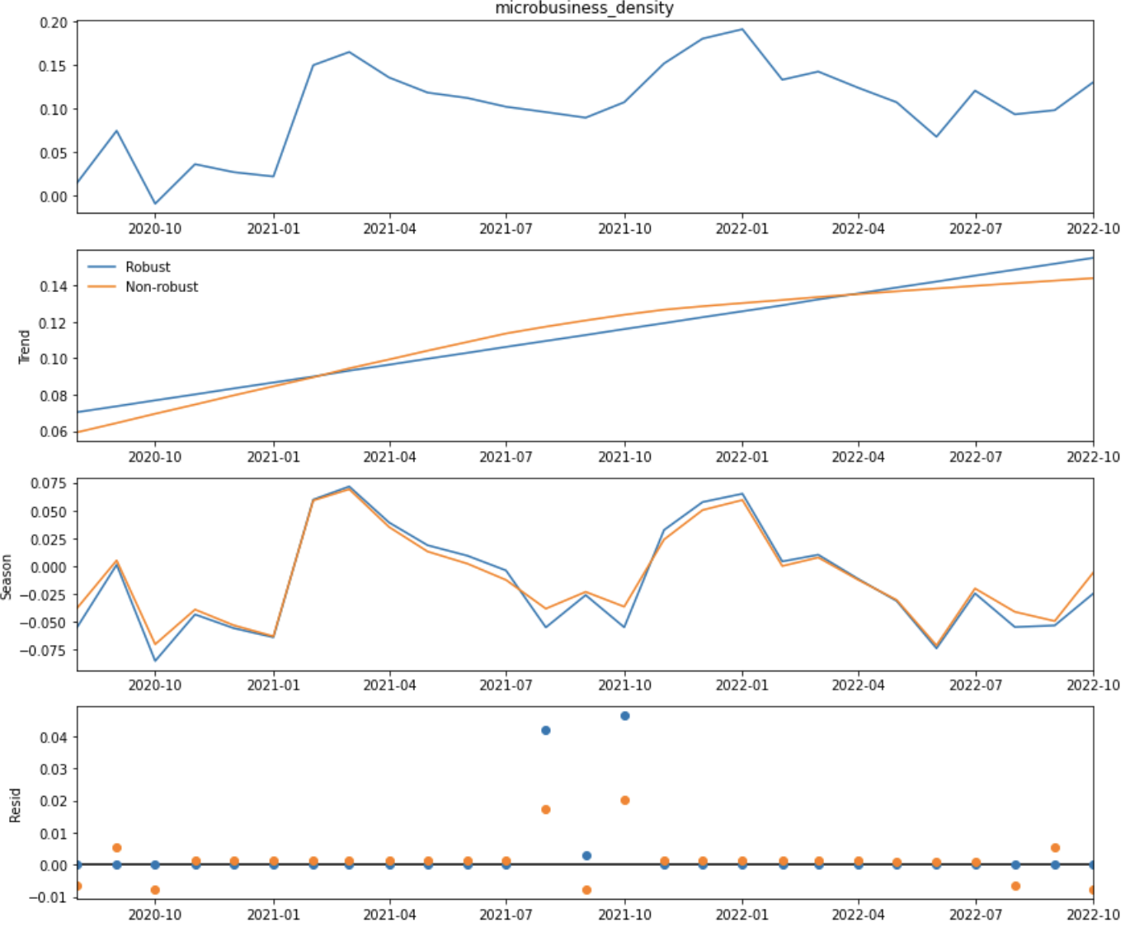
Appendix - Time Series Decomposition
Before Differencing
After Differencing (Reduced Seasonality and Trend)

Slide 28
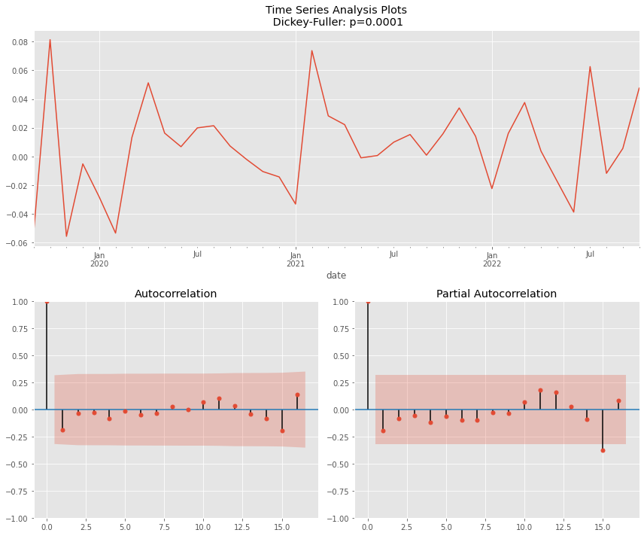
Appendix - Dickey-Fuller Test for Stationarity
The x-axis is the number of lagged periods 𝑘
The y-axis is the autocorrelation coefficient between between -1 and 1 with a confidence interval.
The autocorrelation measures the linear relationship between lagged values of a time series.

Slide 29
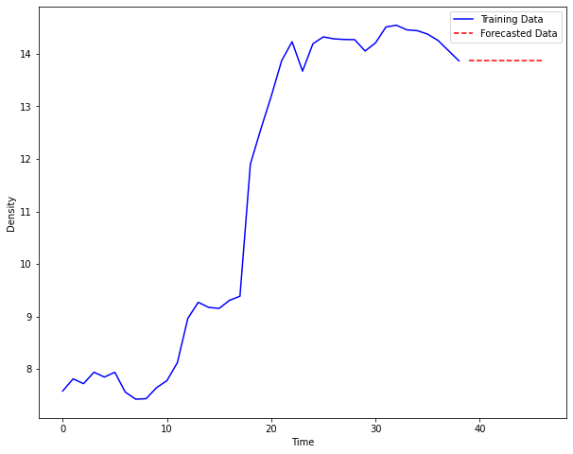
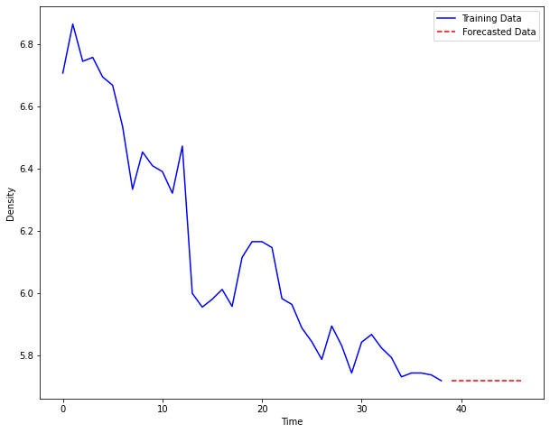
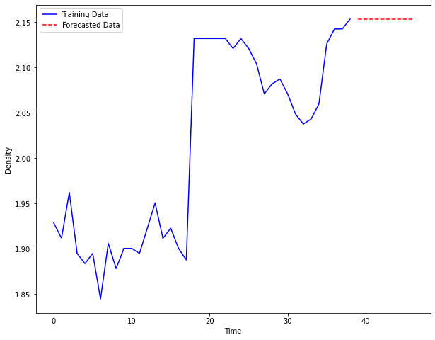
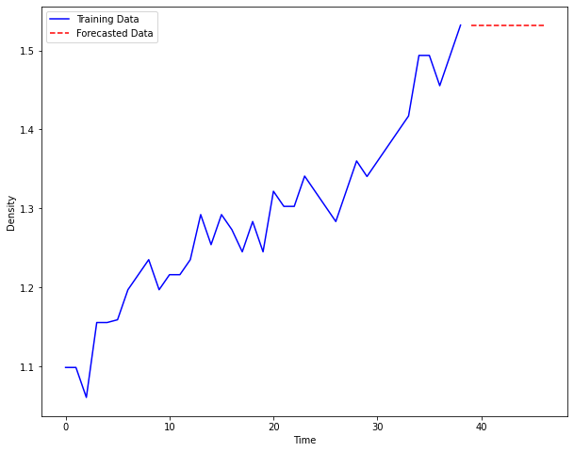
Appendix - Example Forecast

Slide 30
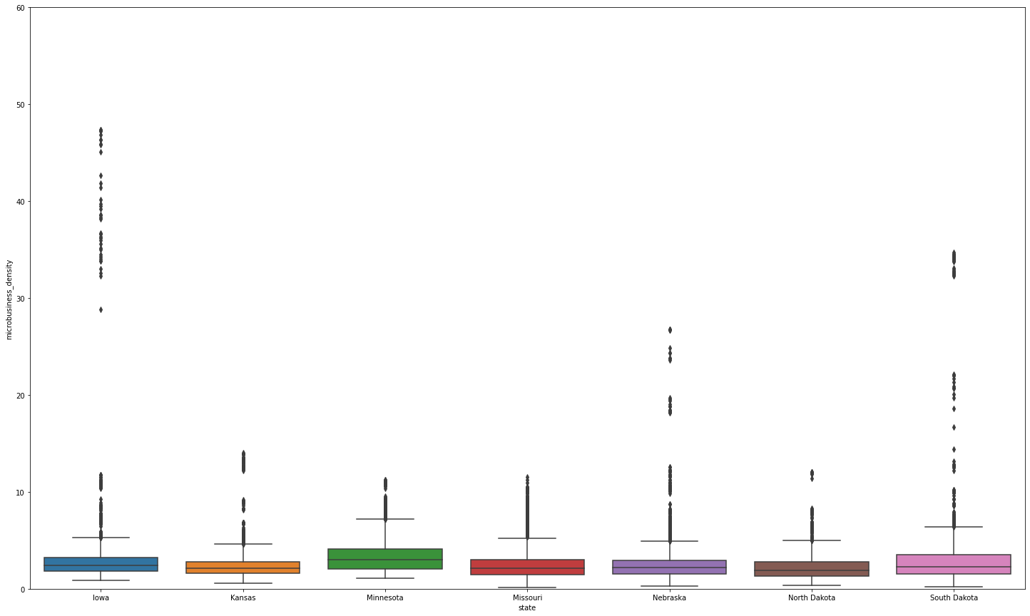
Appendix - Region x Density (West North Central)

Slide 31
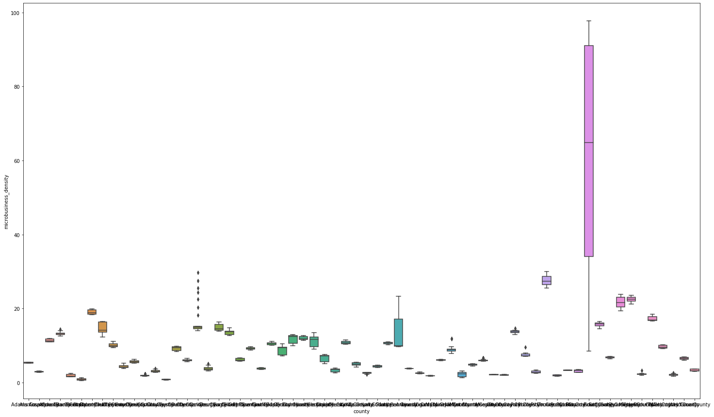
Appendix - Region x Density (Colorado)

Slide 32
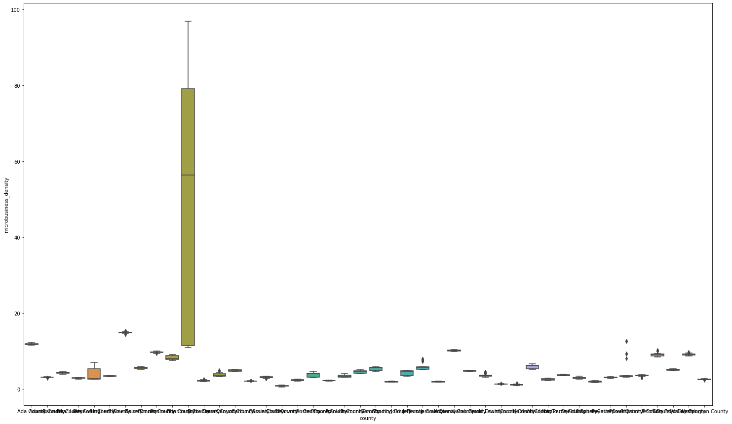
Appendix - Region x Density (Idaho)

Slide 33
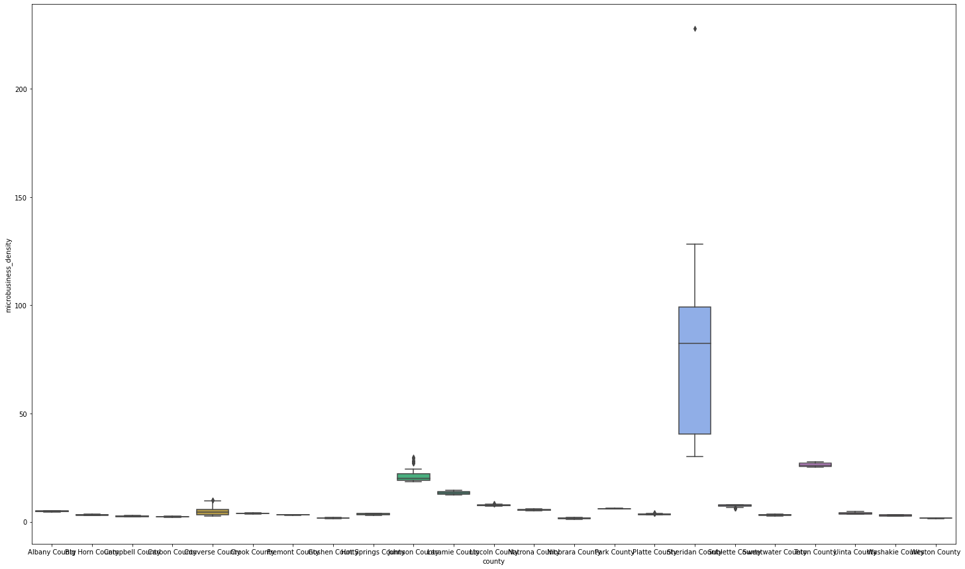
Appendix - Region x Density (Wyoming)

Slide 34
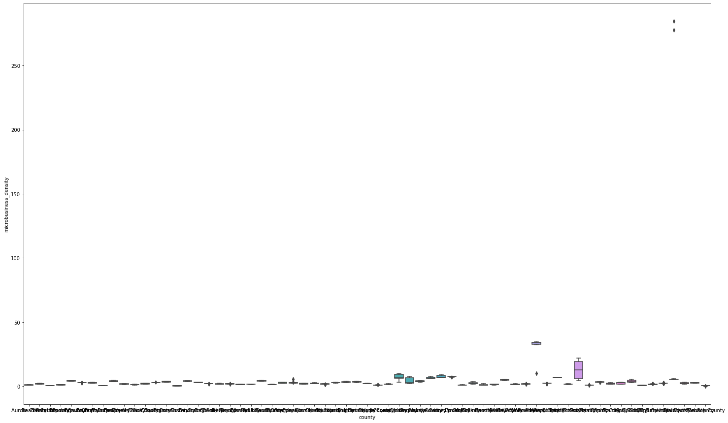
Appendix - Region x Density (South Dakota)

Slide 35
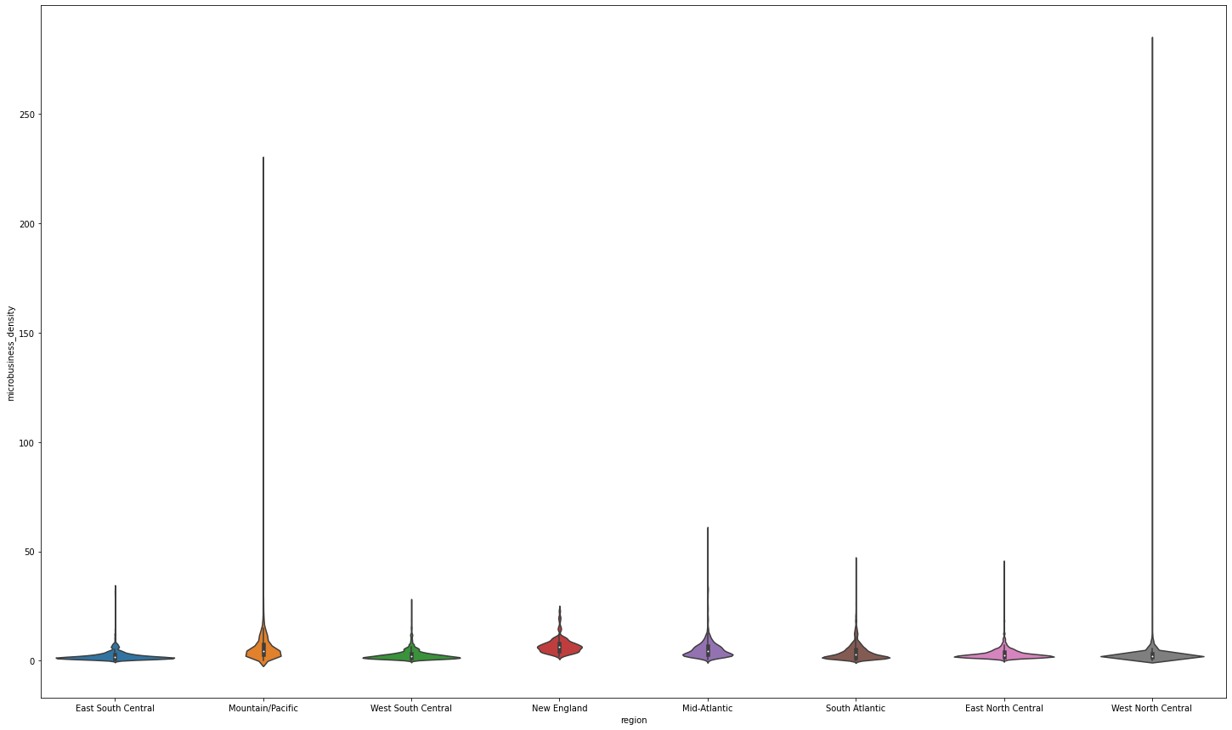
Appendix - Region x Density (Violin)

Slide 36
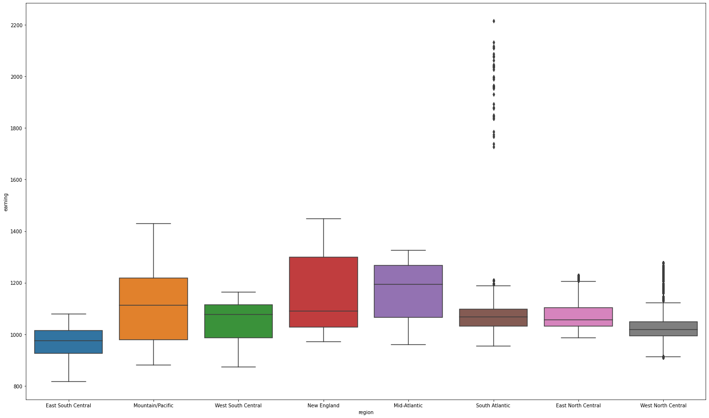
Appendix - Region x Earning

Slide 37
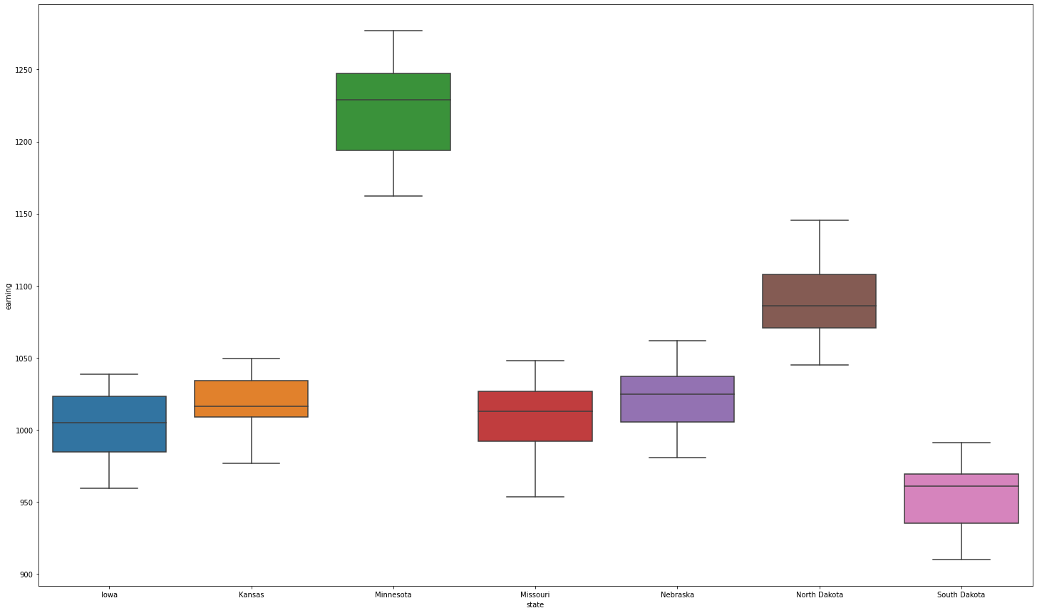
Appendix - Region x Earning (West North Central)

Slide 38
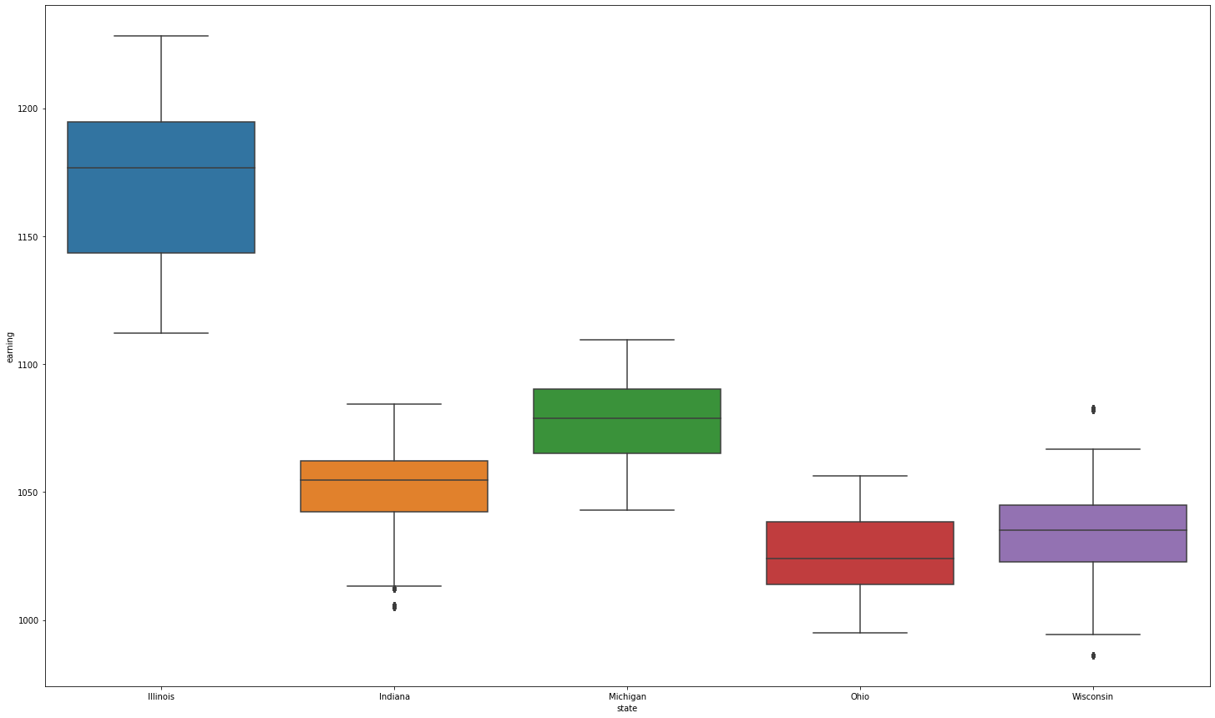
Appendix - Region x Earning (East North Central)

